Slide 1
JOB SKILL EXTRACTION AND NORMALIZATION USING NLP
An NLP-Based Job Market Analysis Project
Presented by : JAIRAJ CHOUDHARY Course : Data Analytics Project Duration : Day 1 – Day 18

Slide 2
Problem Statement
Content :
Job descriptions contain a large amount of unstructured text. Identifying and standardizing technical skills from these descriptions manually is difficult and time-consuming.
Job descriptions contain unstructured information.
Skill may appear in different formats.
The same skill can have multiple names.
Manual extraction can lead to inconsistency.
NLP can be used to extract and standardize skills.

Slide 3
Business Use Case
Recruitment
Identify required skills for jobs.
Job Matching
Match candidates with relevant jobs.
Skill Demand Analysis
Find the most demanded skills.
Career Insights
Understand which skills are valuable in the job market.
Dashboard & Reporting
Convert skill data into useful visualizations.

Slide 4
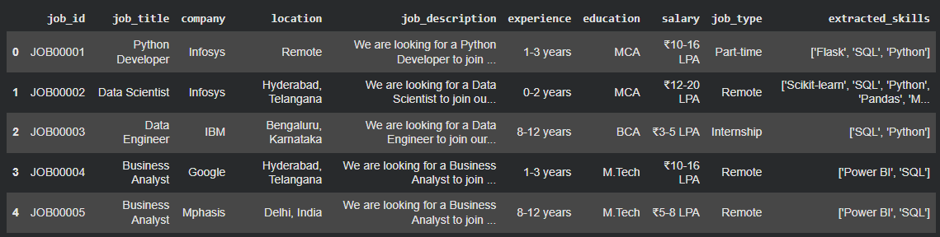
Dataset
Dataset Type : Job/Recruitment Dataset
Main NLP Field : Job description
Skill Field : Extracted skills

Slide 5
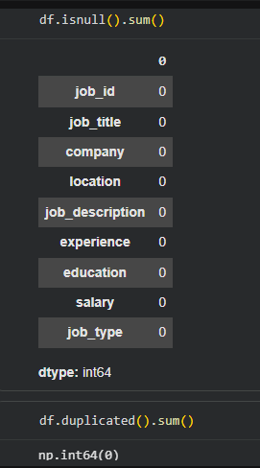
Data Cleaning & Preprocessing
Missing-value handling
Duplicate checking
Text cleaning
Lowercase conversion
Special-character handling
Data standardization

Slide 6
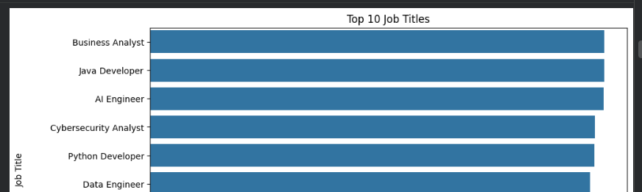
Exploratory Data Analysis(EDA)
Top Job Titles
Jobs by Location
Experience Distribution
Salary Distribution
Most Common Skills
EDA helped identify patterns in job titles, experience, salary and skill requirements.

Slide 7
NLP Pipeline
Job Description
↓
Text Preprocessing
↓
Tokenization
↓
Stopword Handling
↓
NLP Processing
↓
Skill Extraction
↓
Skill Normalization
↓
Final Skill Dataset

Slide 8
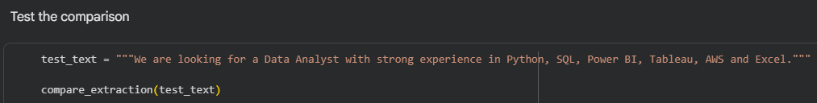
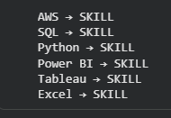
Rule Based Approach
A rule-based approach identifies skills using predefined keywords, patterns and dictionaries
Job Description :
Extracted Skills :

Slide 9
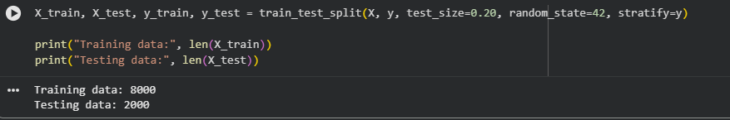
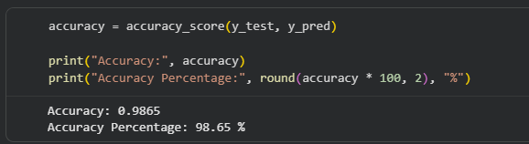
Machine Learning Approach
Machine learning can learn patterns from labeled data.
Features can be created from job-description text.
The model can classify or identify relevant skills.
ML can reduce dependence on manually written rules.
Model :
Accuracy :

Slide 10
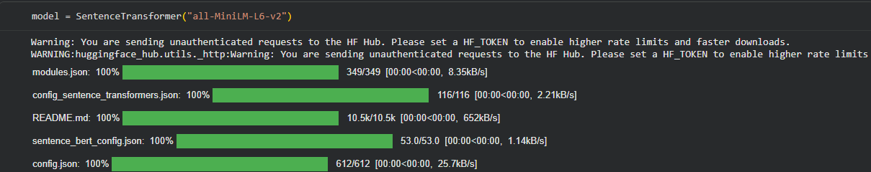
Transformer Approach
Transformer-based NLP models can understand the context and semantic meaning of words in job descriptions.
Better contextual understanding
Can identify differently worded skills
Useful for advanced skill extraction
More computationally expensive
Suitable for future improvement if not implemented

Slide 11
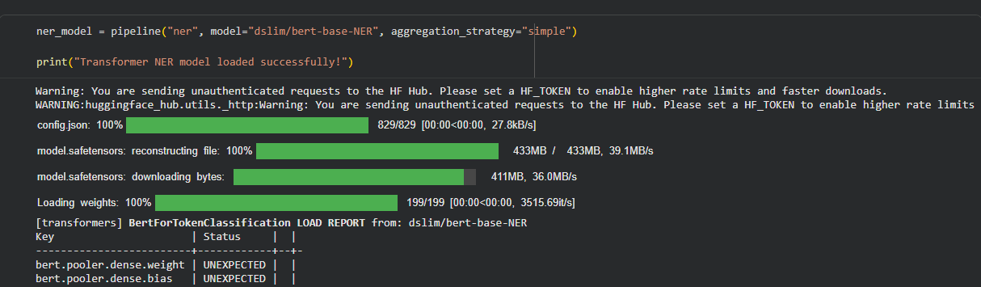
Model Comparison
Approach | Technique / Model | Advantage
Rule-Based | Keyword / Alias Rules | Simple & Fast
Machine Learning | TF-IDF + Logistic Regression | Learn patterns
Transformer | BERT NER(dslim / bert-base-NER) | Strong contextual understanding

Slide 12
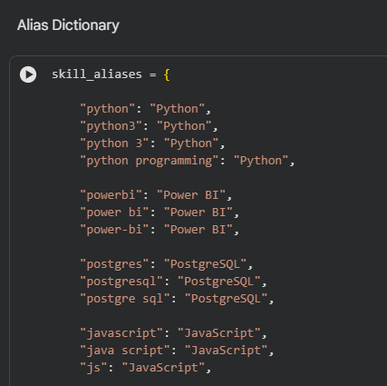
Error Analysis
Misspelled skills
Unknown skills
Different skill formats
Special characters
New / unseen aliases
Multiple skills in one text field

Slide 13
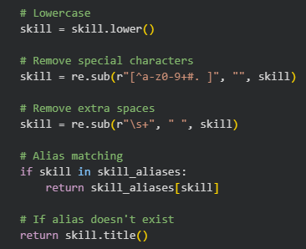
Skill Normalization
Raw Skill
↓
Lowercase
↓
Remove Special Characters
↓
Alias Matching
↓
Canonical Skill

Slide 14
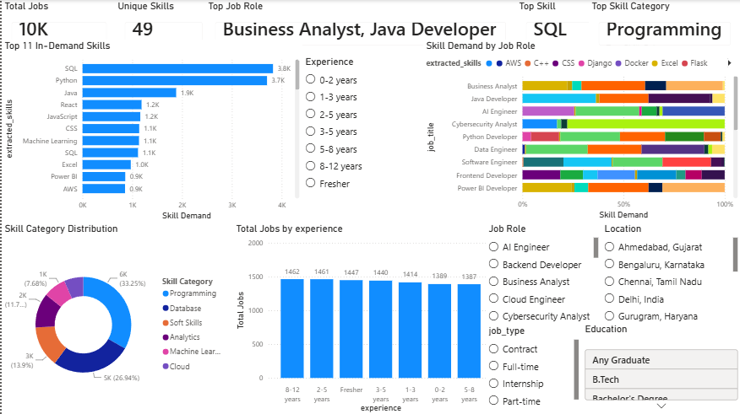
Dashboard
Total Jobs
Top Skills
Jobs by Location
Jobs by Job Title
Salary Analysis
Skill Distribution

Slide 15
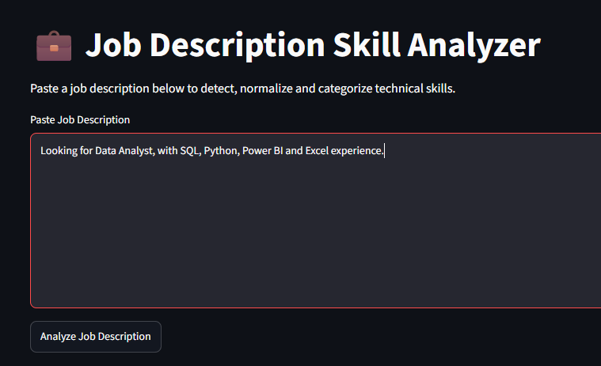
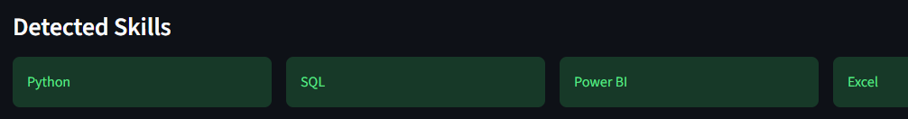
Application Demo
Input :
Output :

Slide 16
Conclusion
NLP helps process unstructured job descriptions.
Skills can be extracted and standardized.
Normalization improves consistency.
The processed data can be used for analysis and dashboards.

Slide 17
Future Improvements
Expand the skill alias dictionary.
Add fuzzy matching.
Handle spelling mistakes.
Add more advanced ML models.
Explore transformer-based approaches.
Improve automatic detection of new skills.

